Slide 1

Temporary Flood
Barriers for Critical Infrastructure Protection
A Study by Marshall University’s Center for Environmental, Geotechnical and Applied Sciences (CEGAS)
CDBG-MIT Planning Project
“Evaluation of Short Term Flood Control Barriers for
Critical Infrastructure” (Project # RPMTPLMID0017)
Updated Presentation February 2025

Slide 2
Background / reason for Study
Multiple documented flood events have occurred in most WV counties over the past 100+ years
These flooding events combined have caused hundreds of millions of dollars in damages to homes, businesses and infrastructure
Infrastructure and community components critical for local community vitality need to be protected, if possible, to increase community resiliency and reduce recovery time in future flooding events
Temporary flood barrier products may provide some level of flood protection for certain critical infrastructure and community components - this study attempted to provide an initial overview of these products and offer some recommendations

Slide 3
Temporary flood barriers
Temporary Flood Barrier Products / Systems have been used in other countries for decades with various degrees of success
These products are now readily available in the U.S.
Systems include, among others, water filled, air filled, and stand-alone designs, and are reusable and can be stored onsite.
Specific flood barrier products must be selected based on site-specific features (topography, surface materials, storage capacity, etc.), flooding history, available storage space, and anticipated future flooding events
Note: CEGAS only evaluated temporary flood barrier products that (1) don’t require heavy equipment, (2) can be installed in relatively short time periods, and (3) minimal personnel needed for installation. Permanently installed flood barrier products were not evaluated as part of this study.
{Marshall University and CEGAS are not endorsing any flood barrier product(s); this presentation is only for discussion and informational use. Additional temporary flood barriers are available that were not included in this study}

Slide 4
Temporary flood barrier
Water Filled Systems
Systems include BoxBarrier ™, Muscle Wall™, and Beaver ™ products
Uses water to secure components in-place
Advantages:
  Available in various heights (up to 8 feet)
  Does not require heavy equipment for installation
Disadvantages:
  Must have available water supply with quick-fill capacity equipment on-site
  Must have personnel available “when needed” for system installation

Slide 5
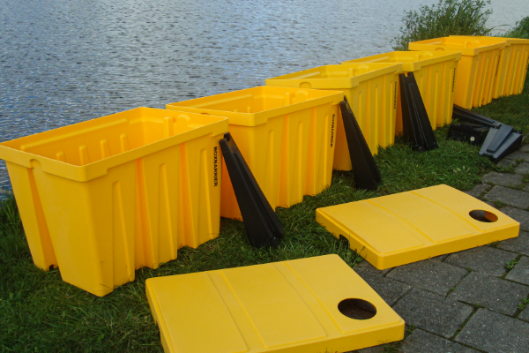
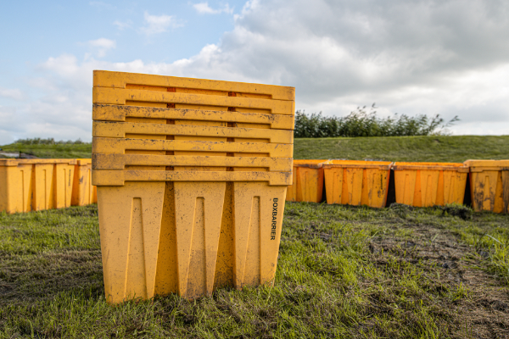
Box
Barrier
(Limited to ~20-inch height)
Photos by Bluemont Flood

Slide 6
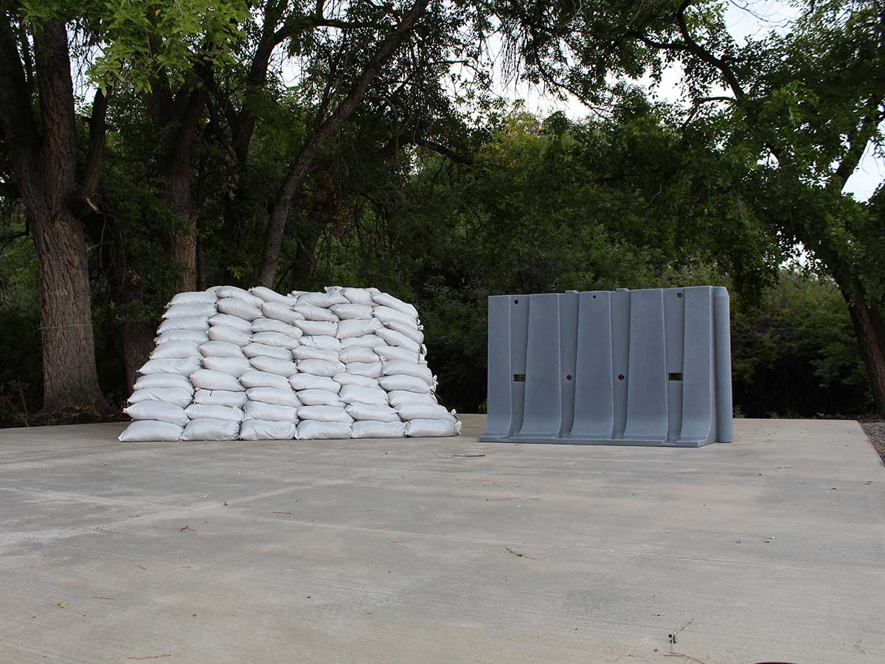
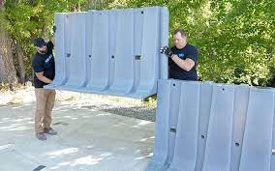

Muscle
Wall flood mitigation approved (by USACE) for 4‘ water height (up to 8’ height available)
Photos by Flood
Defense Group

Slide 7
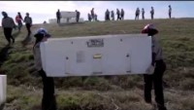
Muscle
Wall
Video link
https://www.youtube.com/watch?v=eHSsHfgQSJc

Slide 8
Temporary flood barrier air filled Systems
Systems include NOAQ Tubewall ™ and Serpent ™ Inflatable Flood Control Tube products
Uses air to inflate systems to form a continuous protective barrier
Advantages:
  Available in various heights (up to ~39 inches)
  Does not require heavy equipment for installation
Disadvantages:
  Must have available air inflation equipment on-site
  May not be able to handle flood debris impacts during flood events
  Must have personnel available “when needed” for system installation

Slide 9
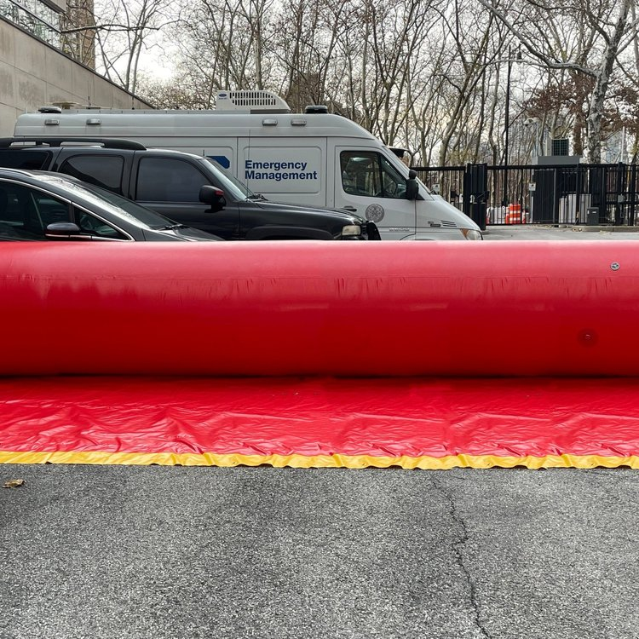
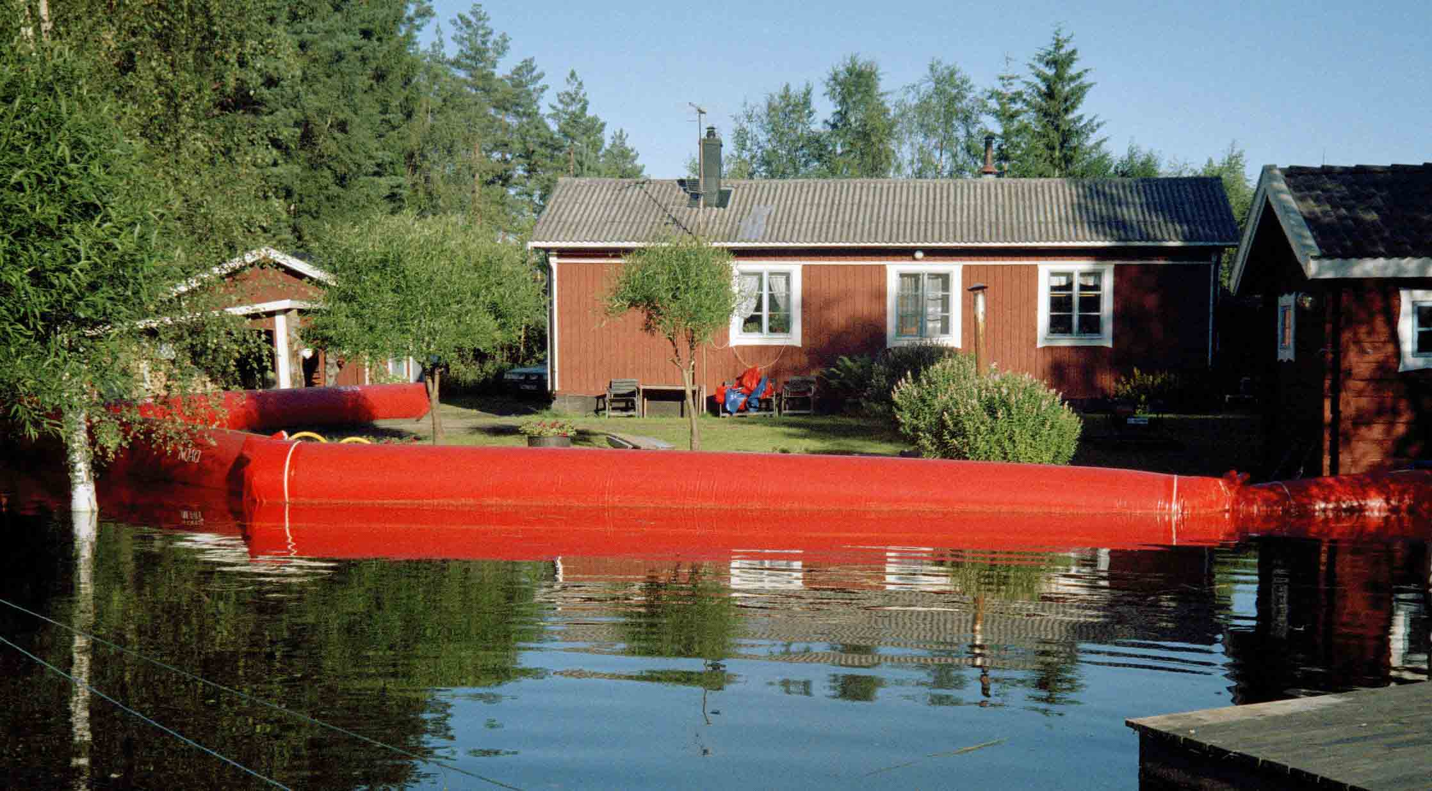
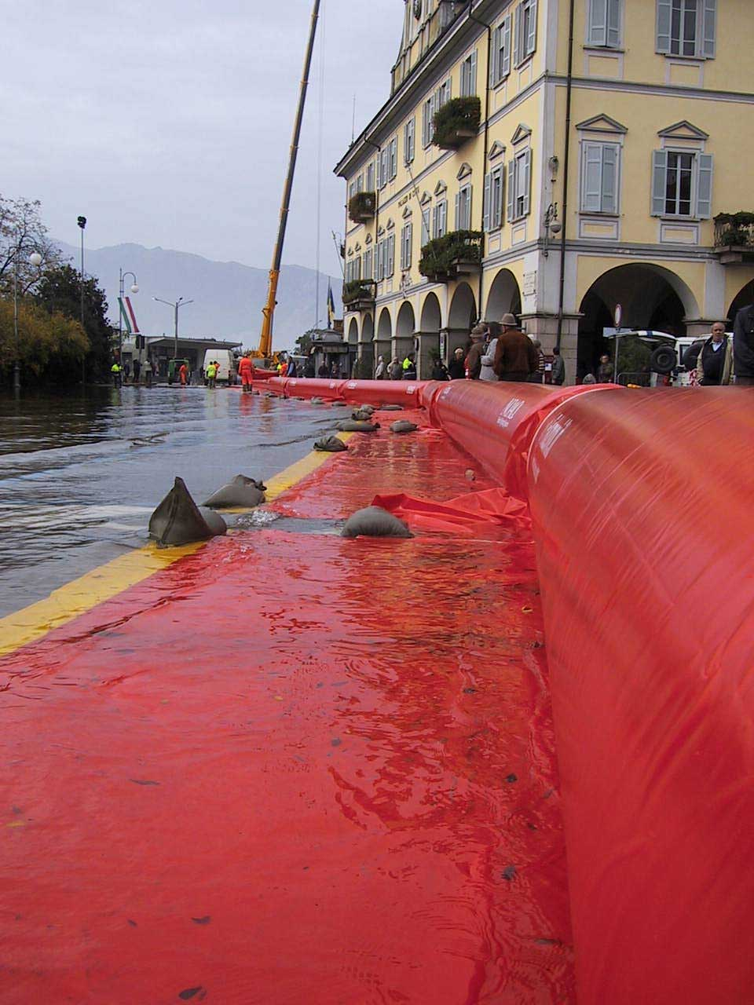
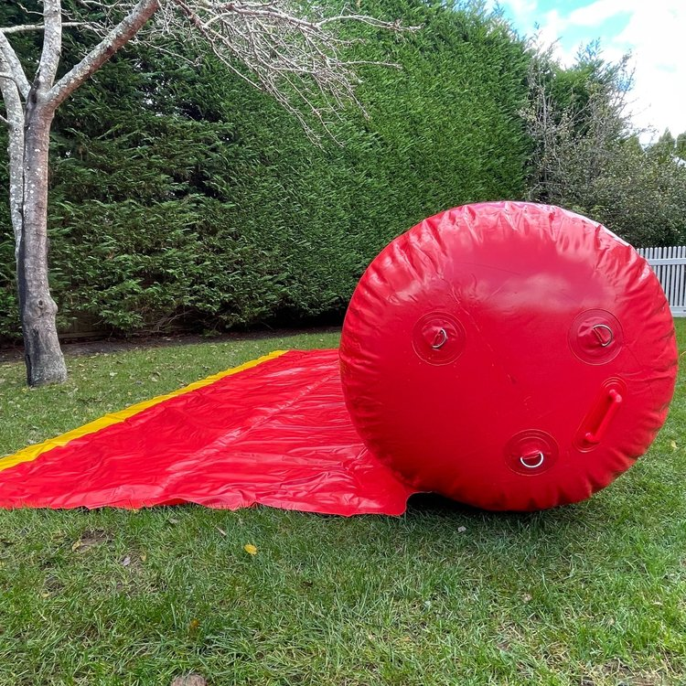
Noaq Tubewall &
Serpent Inflatable Flood Control Tube
Photos by Garrison Flood Control and
Flood Control International

Slide 10
Temporary flood barrier stand-alone Systems
Systems include NOAQ Box wall ™ and Mayim ™ Modular Flood Barrier products
Self-anchoring (automatically ballasted by flood water weight
Advantages:
  Available in heights up to ~39 inches
  Does not require heavy equipment for installation
  Easy storage
Disadvantages:
  Must have at least one person available “when needed” for system installation

Slide 11
Noaq boxwall
Photos by NOAQ

Slide 12
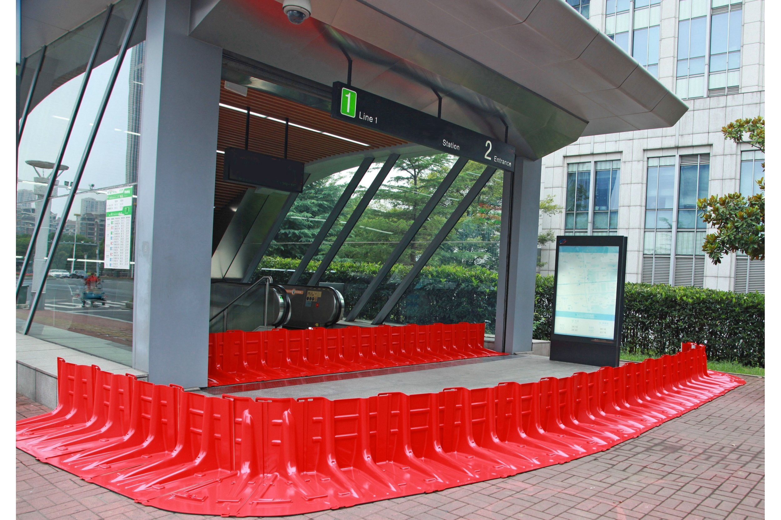
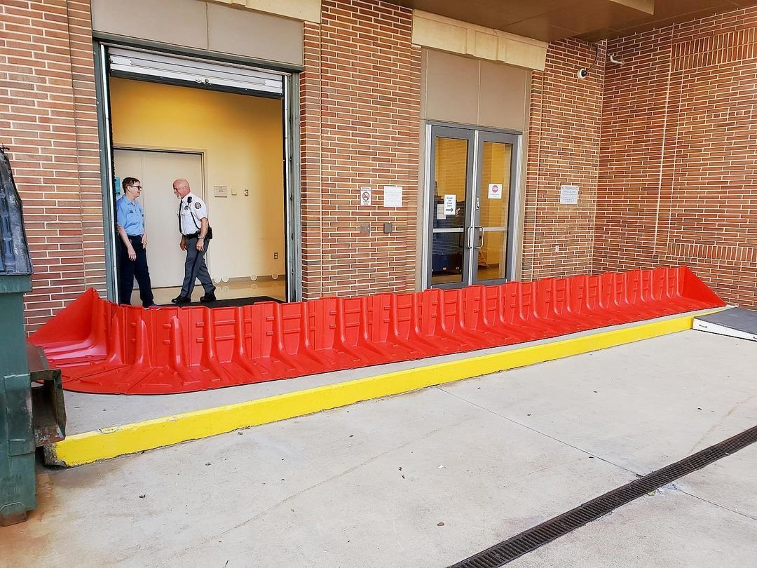
Mayim Modular Flood barrier
Photos by Garrison Flood Control

Slide 13
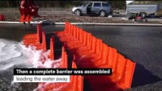
Noaq boxwall
Video links https://www.youtube.com/watch?v=ZAf3SjQ1WN4

Slide 14
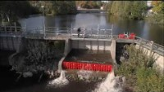
Noaq boxwall
Video links
https://www.youtube.com/watch?v=MjopgWKUqoQ

Slide 15
Temporary flood barrier
Building Entry Protection Systems
Systems include Dam Easy ™, Presray Flood Panels ™, EZ Flood Panel™ and Legacy Flood Barrier ™ products (and many more)
These products generally require a “bolt-on” building process for anchoring
Advantages:
  Available in multiple heights and stackable for increased heights
  Does not require heavy equipment for installation
  Can provide cost savings compared to other temporary flood barrier systems
Disadvantages:
  Must have one or more personnel available “when needed” for system installation
  Most Systems require installation of “bolt-on” equipment prior to use

Slide 16
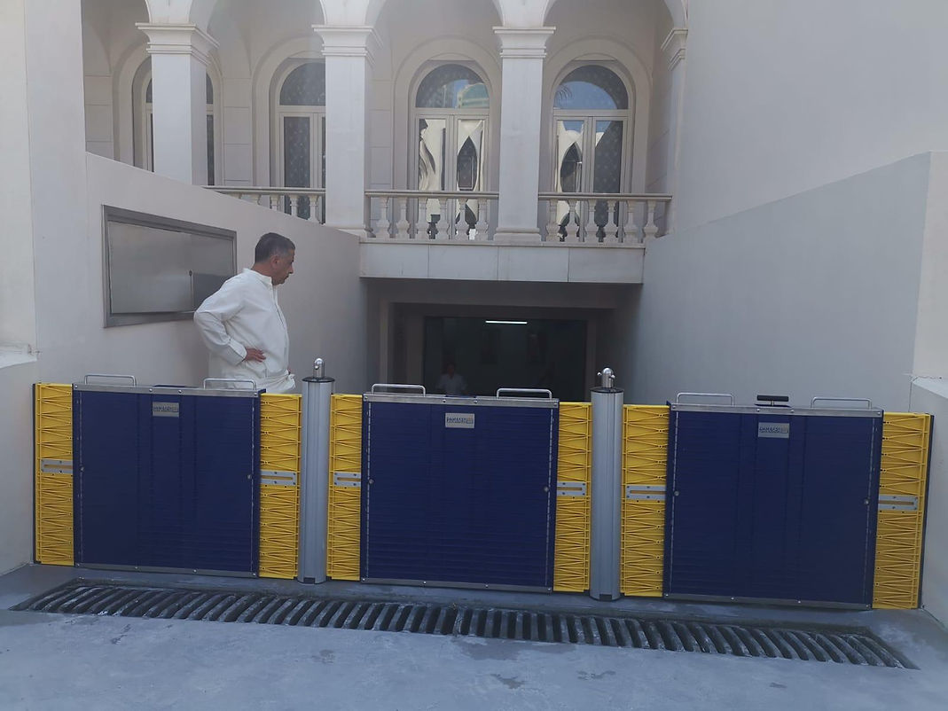
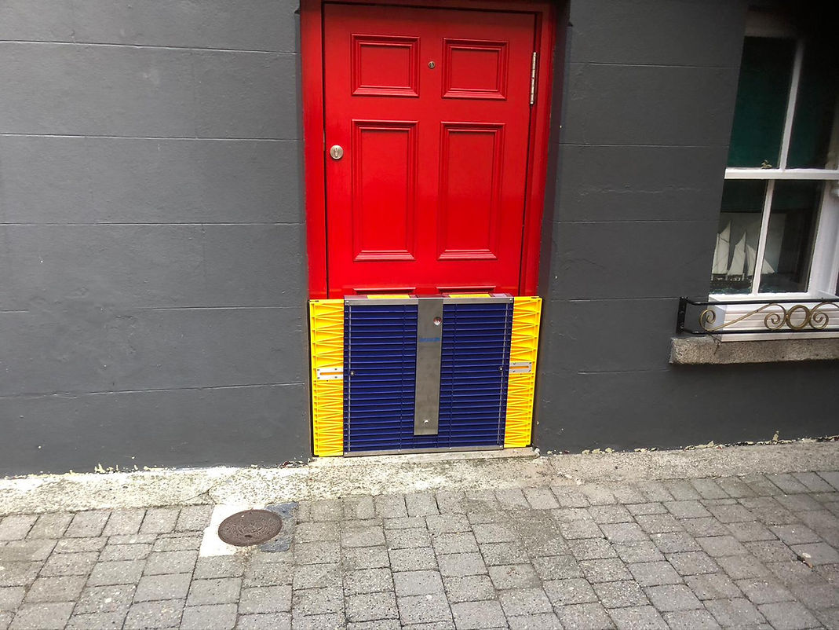
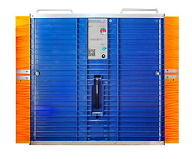
Dam easy
Photos by Flood Proofing.com

Slide 17
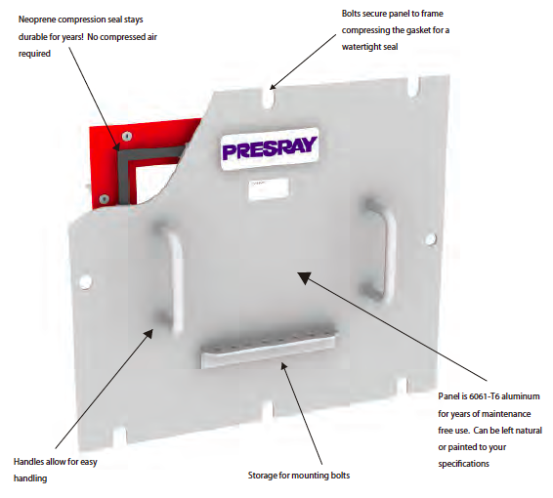
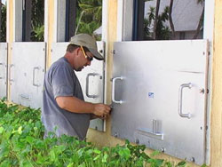
Presray flood panel
Photos by Presray

Slide 18
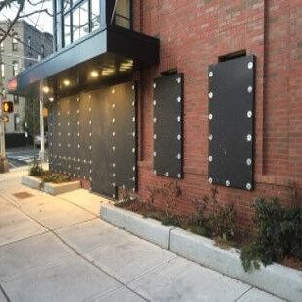
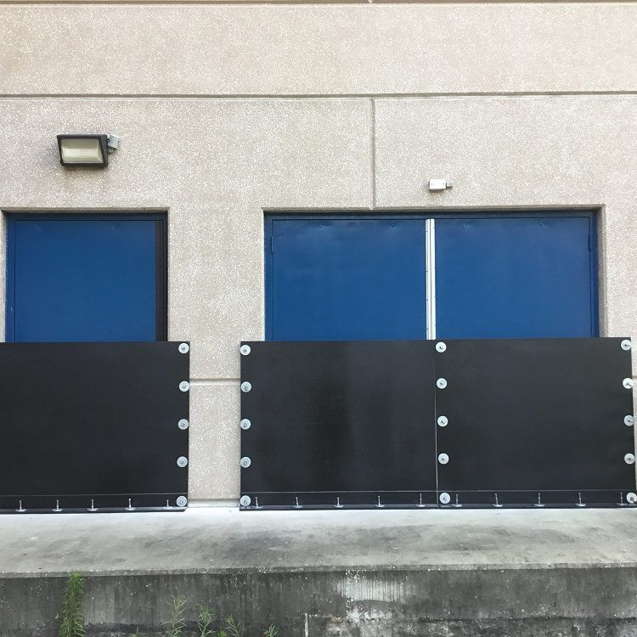
EZ flood panel
Photos by Flood Defense Group

Slide 19
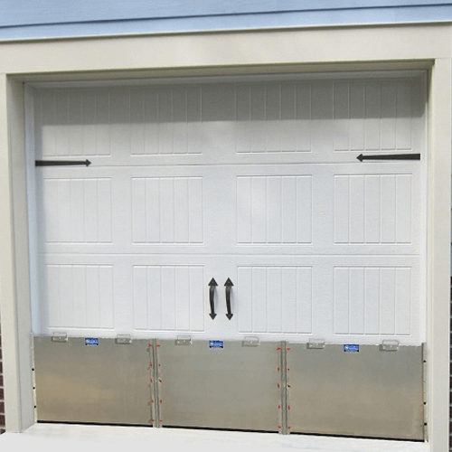
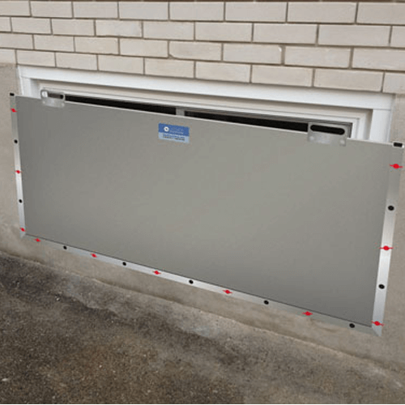
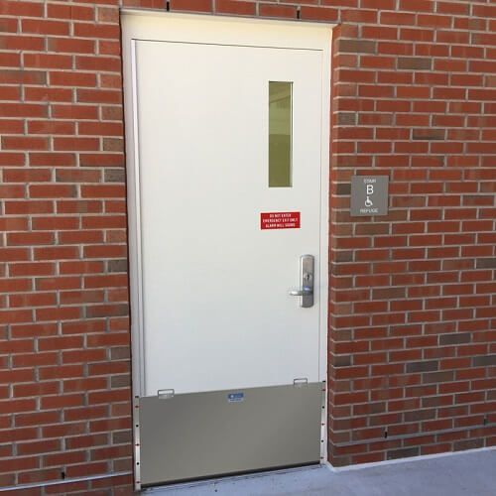
Legacy flood Barrier
Photos by Flood Defense Group

Slide 20
Summary of CEGAS Site Reviews
Over 50 locations were initially evaluated for future temporary flood barrier use (in 12-county area of June 2016 flood event).
Locations evaluated included water treatment facilities, sewage treatment facilities, fire stations, grocery stores, post offices and pharmacy stores
Historical flooding events were documented at each location
Specific site features have been recorded (surface types, topography, damage estimates, and potential storage areas for flood barrier products)
Suggestions / recommendations have been made for potential temporary flood barrier products that are a “good fit” for 32 of the sites; other sites initially evaluated were not conducive of temporary flood barrier use.
Each site evaluated included estimated costs for flood barrier system(s) selected.
Site-specific reports were compiled into a final report.

Slide 21
Conclusions
CONCLUSIONS
Temporary Flood Barrier Products can provide some level of protection for many critical infrastructure facilities that have experienced past flooding events, and/or are expected to experience future flooding events.
Some locations will not benefit from these products (due to flooding heights, floodway locations, and site-specific features and conditions).
Cost: The higher the flood protection height, the higher the cost.
Must have personnel available for system installation when needed.
CEGAS has recommended purchasing of temporary flood barrier products at select locations as a pilot for education, research and future evaluation.
Potential funding sources need to be identified to purchase these products. Possible funding sources include FEMA’s BRIC, HUD pre-disaster planning, U.S. Army Corps of Engineers Section 205 (flood damage assistance), and USDA Rural Development “Water & Environmental” programs. Other federal, state and private foundation funding sources may also exist and need to be researched.

Slide 22
Report Contacts
To discuss this presentation further, contact Marshall University’s Center for Environmental, Geotechnical and Applied Sciences (CEGAS)
George Carico, Environmental Manager
Phone: 304/696-5456
Email: carico@marshall.edu
For additional information on flood resiliency, contact Marshall University’s Appalachian Resiliency Center
James Wolfe, Interim Director
Phone: 304/696-6042
Email” jawolfe@marshall.edu

